Slide 1
UIT2301 – Programming and Design Patterns
Lecture-09
Template Design Pattern
Object Behavioral

Slide 2
Introduction
Intent:
Define the skeleton of an algorithm in an operation, deferring some steps to subclasses.
Template Method lets subclasses redefine certain steps of an algorithm without changing the algorithm's structure.

Slide 3
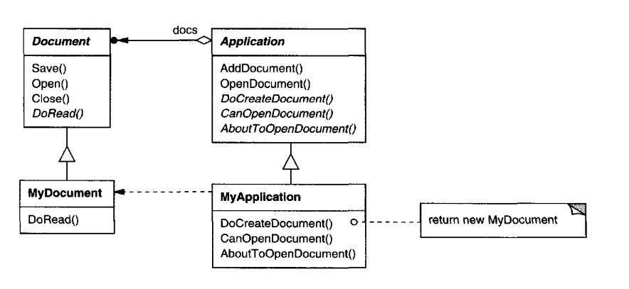
Introduction
Motivation:

Slide 4
Introduction
Applicability :
to implement the invariant parts of an algorithm once and leave it up to subclasses to implement the behavior that can vary.
when common behavior among subclasses should be factored and localized in a common class to avoid code duplication.
to control subclasses extensions. You can define a template method that calls "hook" operations (see Consequences) at specific points, thereby permitting extensions only at those points.

Slide 5
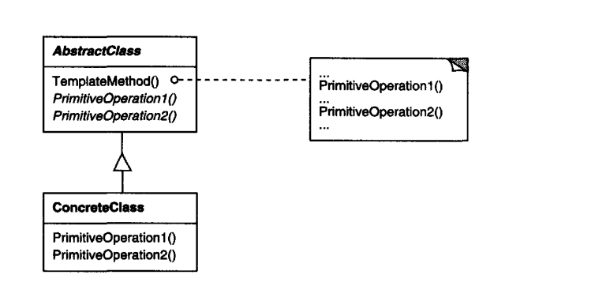
Introduction
Structure

Slide 6
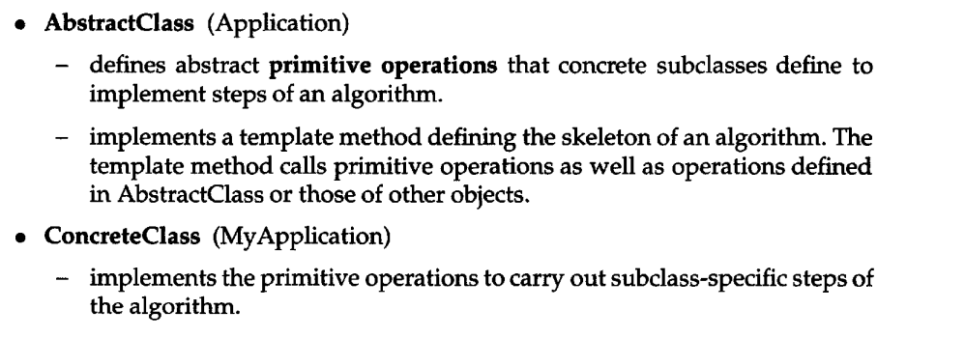
Introduction
Participants

Slide 7
Introduction
Consequences:
Template methods call the following kinds of operations:
concrete operations (either on the ConcreteClass or on client classes);
concrete AbstractClass operations (i.e., operations that are generally useful to subclasses);
primitive operations (i.e., abstract operations); and
hook operations, which provide default behavior that subclasses can extend if necessary. A hook operation often does nothing by default

Slide 8
Activity01: Case study Discussion

Slide 9
Implementation
class Baking_Cake(ABC):
@abstractmethod
def get_ingredients(self):
pass
@abstractmethod
def mix_all(self):
pass
@abstractmethod
def baking(self):
pass
def process_cake_making(self):
print("Preparing a Cake")
self.get_ingredients()
self.mix_all()
self.baking()
print("Serve the Cake")

Slide 10
Activity02: Quiz (Python 3 – OOP – Dusty Phillips -pg:265)

Slide 11
Books
TEXTBOOKS:
Dusty Phillips, “Python 3 Object-Oriented Programming: Build robust and maintainable software with object-oriented design patterns in Python 3.8”, Third Edition, Packt Publishing, 2018.
REFERENCES:
Matt Weisfeld, “Object-Oriented Thought Process”, Fifth Edition, Addison-Wesley Professional, 2019.
Matthias Noback, “Object Design Style Guide”, Manning Publications, 2020.
Stephen F. Lott, “Mastering Object-oriented Python”, Second Edition, Packt Publishing, 2019.
Mark Lutz, “Programming Python: Powerful Object-Oriented Programming”, Fourth Edition, O’Reilly Media, 2011.

